Slide 1
Kleen’s Theorem
Presented by: Siraj Dujana Qureshi

Slide 2
What are the Regular Languages?
Language means a set of strings over an alphabet that follow certain rules.
Language of all strings over {a, b} with only a’s
Example: { "", "a", "aa", "aaa", ... }
Regular Expression (RE): a*
Language of strings that start with ‘a’ and end with ‘b’
Example: { "ab", "aab", "abb", "aaab", ... }
RE: a(a+b)*b

Slide 3
What are the Regular Languages?
A regular language is a set of strings (words) that can be:
Described by a Regular Expression
Accepted by a Finite Automaton
✅ Examples of Regular Languages:
All strings made of only as and bs Regular expression: (a + b)* Accepts: "", a, b, ab, ba, aab, bbaab, etc.
❌ Not Regular :
Some languages are not regular they are too complex for regular expressions or finite automata.
Example:
Language of strings with equal number of as and bs like:
ab, aabb, abab, baba
But not aab or abb
This cannot be described by a regular expression.
So, it’s not a regular language.

Slide 4
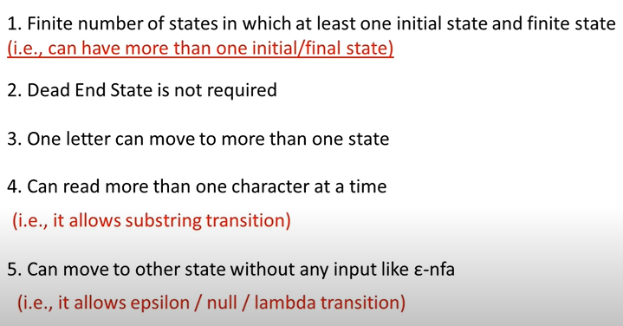
Transition Graph

Slide 5

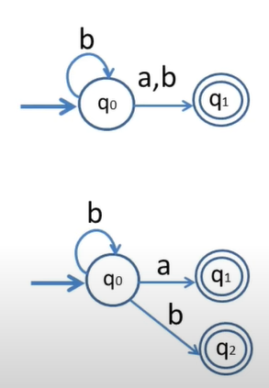
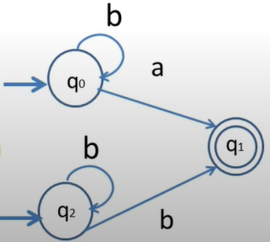
Transition Graph

Slide 6
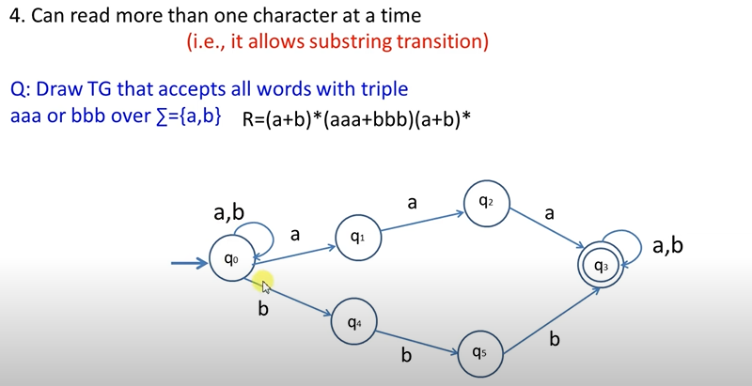
Transition Graph

Slide 7
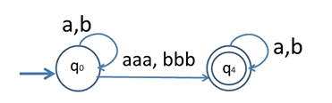
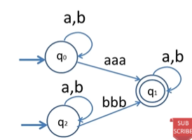
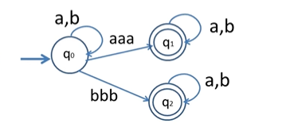
Transition Graph

Slide 8
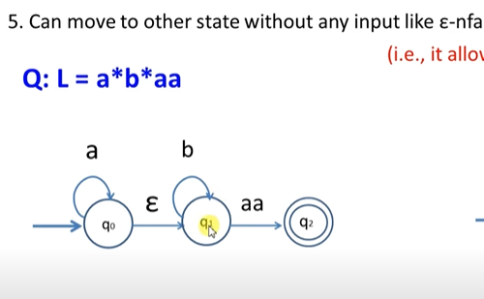
Transition Graph

Slide 9
What is Kleen’s Theorem?
Any language that can be defined by a Regular Expression can also be defined by:
Finite Automaton (FA)
Transition Graph (TG)
All three methods define the same class of languages: Regular Languages.
Notes:
🌍 Real-World Example: Email Validation
🔹 Task:
You want to check if a string is a valid email address, like:
john@example.com
student123@university.edu
✅ Step 1: Use Regular Expression (RE)
A developer writes a regular expression like:
scss
CopyEdit
^[a-zA-Z0-9._%+-]+@[a-zA-Z0-9.-]+\.[a-zA-Z]{2,}$
This RE describes the pattern of a valid email:
Starts with letters/numbers
Has an @ symbol
Followed by a domain name
Ends with .com, .edu, etc.
➡️ This is easy to write and read.
✅ Step 2: Use Finite Automaton (FA)
Inside a program or browser, the RE is converted into a finite automaton.
This automaton:
Reads the email address one character at a time
Changes state depending on the input
Finally accepts or rejects the input
➡️ This is good for efficient processing and running in real time.

Slide 10
Kleen’s Theorem
Language that can be defined by FA can be defined by a TG
Language that can be defined by TG can be defined by a RE
Language that can be defined by a RE can also be defined by FA
Notes:
🌍 Real-World Example: Email Validation
🔹 Task:
You want to check if a string is a valid email address, like:
john@example.com
student123@university.edu
✅ Step 1: Use Regular Expression (RE)
A developer writes a regular expression like:
scss
CopyEdit
^[a-zA-Z0-9._%+-]+@[a-zA-Z0-9.-]+\.[a-zA-Z]{2,}$
This RE describes the pattern of a valid email:
Starts with letters/numbers
Has an @ symbol
Followed by a domain name
Ends with .com, .edu, etc.
➡️ This is easy to write and read.
✅ Step 2: Use Finite Automaton (FA)
Inside a program or browser, the RE is converted into a finite automaton.
This automaton:
Reads the email address one character at a time
Changes state depending on the input
Finally accepts or rejects the input
➡️ This is good for efficient processing and running in real time.

Slide 11
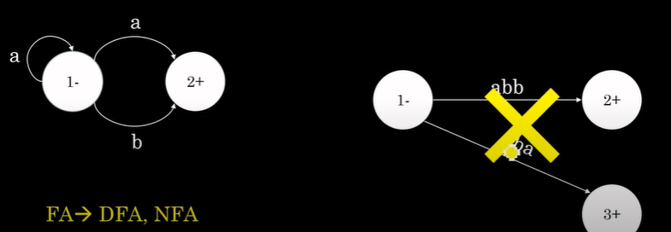
FA (DFA,NFA) > TG
Every Fa is itself already a TG.
Every TG is not FA.
FA(single letters)
TG(multiple letters)
Notes:
🌍 Real-World Example: Email Validation
🔹 Task:
You want to check if a string is a valid email address, like:
john@example.com
student123@university.edu
✅ Step 1: Use Regular Expression (RE)
A developer writes a regular expression like:
scss
CopyEdit
^[a-zA-Z0-9._%+-]+@[a-zA-Z0-9.-]+\.[a-zA-Z]{2,}$
This RE describes the pattern of a valid email:
Starts with letters/numbers
Has an @ symbol
Followed by a domain name
Ends with .com, .edu, etc.
➡️ This is easy to write and read.
✅ Step 2: Use Finite Automaton (FA)
Inside a program or browser, the RE is converted into a finite automaton.
This automaton:
Reads the email address one character at a time
Changes state depending on the input
Finally accepts or rejects the input
➡️ This is good for efficient processing and running in real time.

Slide 12
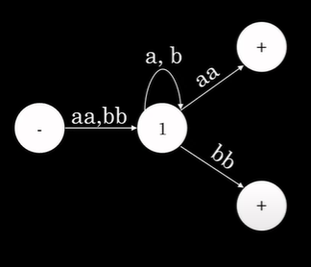

TG > RE
Notes:
🌍 Real-World Example: Email Validation
🔹 Task:
You want to check if a string is a valid email address, like:
john@example.com
student123@university.edu
✅ Step 1: Use Regular Expression (RE)
A developer writes a regular expression like:
scss
CopyEdit
^[a-zA-Z0-9._%+-]+@[a-zA-Z0-9.-]+\.[a-zA-Z]{2,}$
This RE describes the pattern of a valid email:
Starts with letters/numbers
Has an @ symbol
Followed by a domain name
Ends with .com, .edu, etc.
➡️ This is easy to write and read.
✅ Step 2: Use Finite Automaton (FA)
Inside a program or browser, the RE is converted into a finite automaton.
This automaton:
Reads the email address one character at a time
Changes state depending on the input
Finally accepts or rejects the input
➡️ This is good for efficient processing and running in real time.

Slide 13
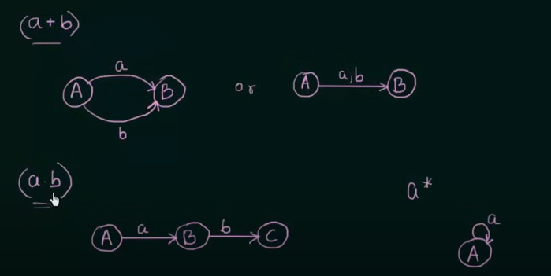
Re to FA
Notes:
🌍 Real-World Example: Email Validation
🔹 Task:
You want to check if a string is a valid email address, like:
john@example.com
student123@university.edu
✅ Step 1: Use Regular Expression (RE)
A developer writes a regular expression like:
scss
CopyEdit
^[a-zA-Z0-9._%+-]+@[a-zA-Z0-9.-]+\.[a-zA-Z]{2,}$
This RE describes the pattern of a valid email:
Starts with letters/numbers
Has an @ symbol
Followed by a domain name
Ends with .com, .edu, etc.
➡️ This is easy to write and read.
✅ Step 2: Use Finite Automaton (FA)
Inside a program or browser, the RE is converted into a finite automaton.
This automaton:
Reads the email address one character at a time
Changes state depending on the input
Finally accepts or rejects the input
➡️ This is good for efficient processing and running in real time.

Slide 14
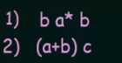
RE to FA
Notes:
🌍 Real-World Example: Email Validation
🔹 Task:
You want to check if a string is a valid email address, like:
john@example.com
student123@university.edu
✅ Step 1: Use Regular Expression (RE)
A developer writes a regular expression like:
scss
CopyEdit
^[a-zA-Z0-9._%+-]+@[a-zA-Z0-9.-]+\.[a-zA-Z]{2,}$
This RE describes the pattern of a valid email:
Starts with letters/numbers
Has an @ symbol
Followed by a domain name
Ends with .com, .edu, etc.
➡️ This is easy to write and read.
✅ Step 2: Use Finite Automaton (FA)
Inside a program or browser, the RE is converted into a finite automaton.
This automaton:
Reads the email address one character at a time
Changes state depending on the input
Finally accepts or rejects the input
➡️ This is good for efficient processing and running in real time.

Slide 15
Why Kleen’s Theorem?
Regular Expressions and Finite Automata are equally powerful.
If a language can be described by a Regular Expression,
It can be recognized by a Finite Automaton and TG.
Vice versa
Notes:
“Kleene’s Theorem is important because it proves that regular expressions and finite automata are equally powerful. That means, if a language can be written using a regular expression, it can also be recognized by a finite automaton — and vice versa. So, both define the same type of languages, called regular languages.”

